Slide 1
Non Medullary Thyroid Cancer & FOXE1 Gene
Franklin Yeo
GEN 564

Slide 2
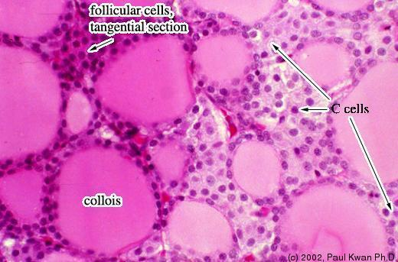
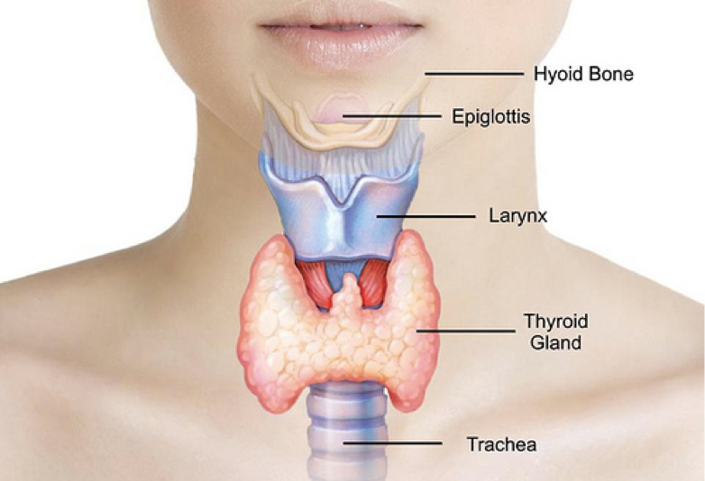
What is Non Medullary Thyroid Cancer (NMTC)?
Abnormal growth of thyroid follicular cells

Slide 3
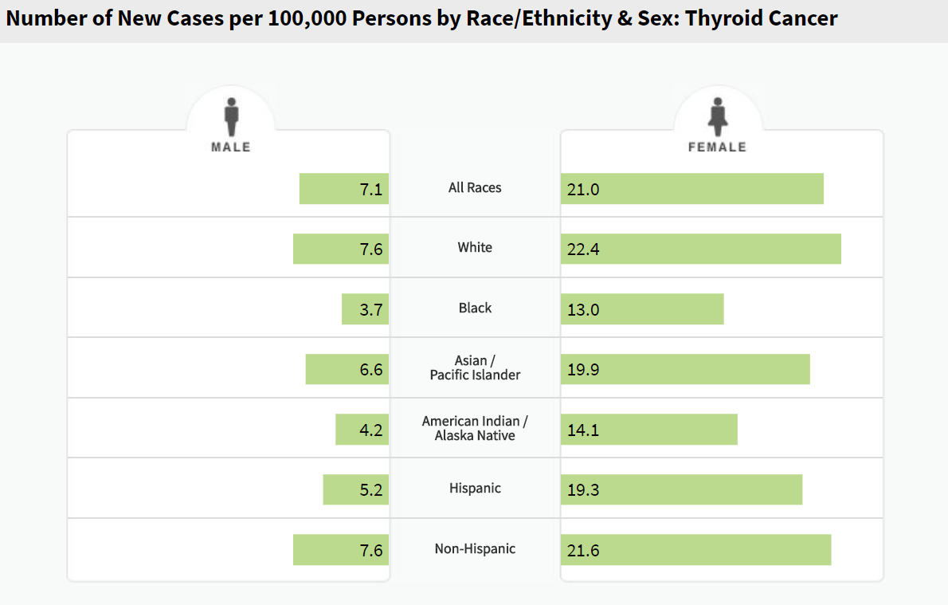
Who does NMTC affect?
More common in those with a family history of thyroid disease

Slide 4
What are the symptoms of NMTC?

Slide 5
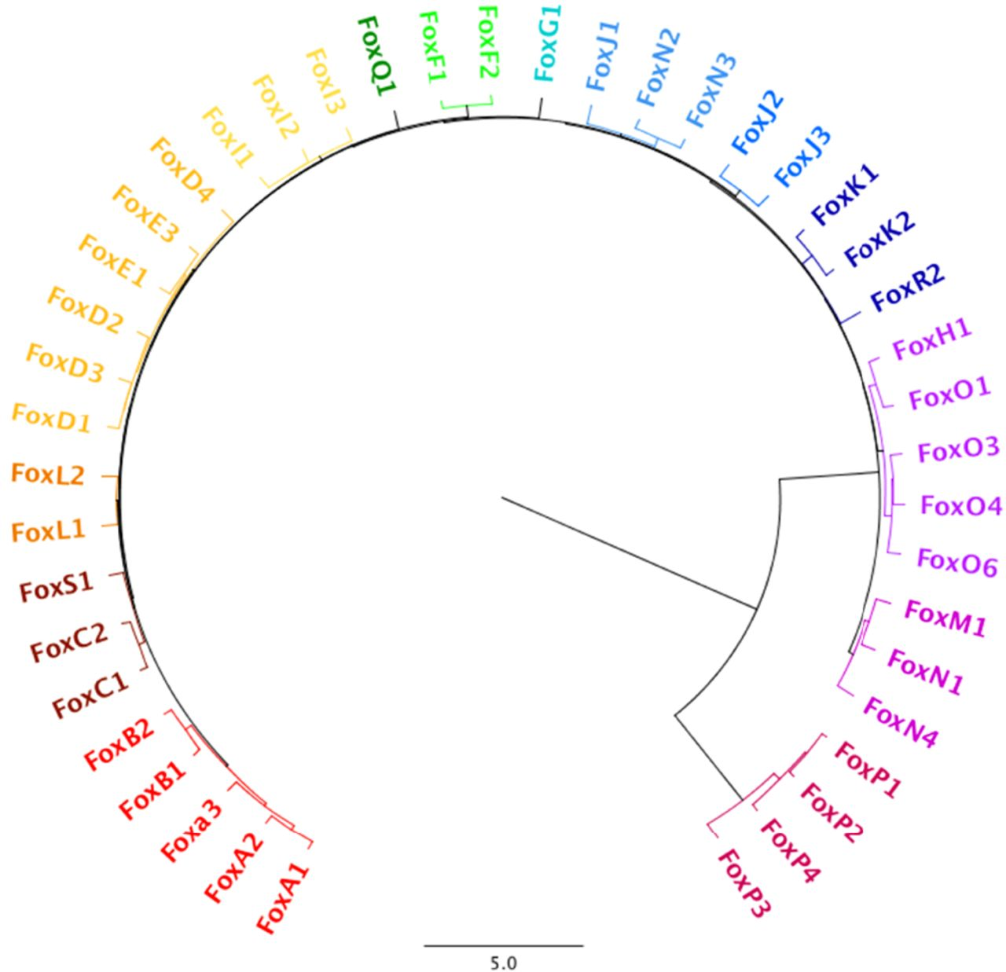
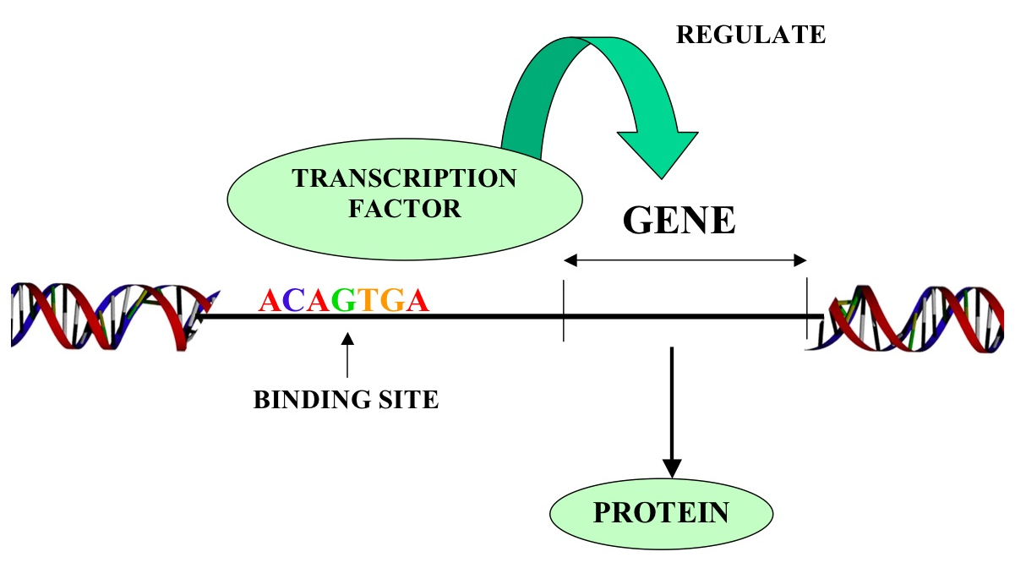
What is FOXE1?
Thyroid Transcription Factor
Forkhead box protein family
Pioneer factors: transcription factors that can bind directly to condensed chromatin and can positively/negatively affect transcription

Slide 6
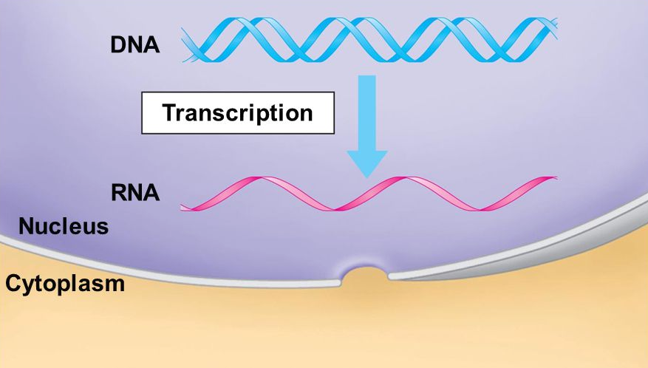
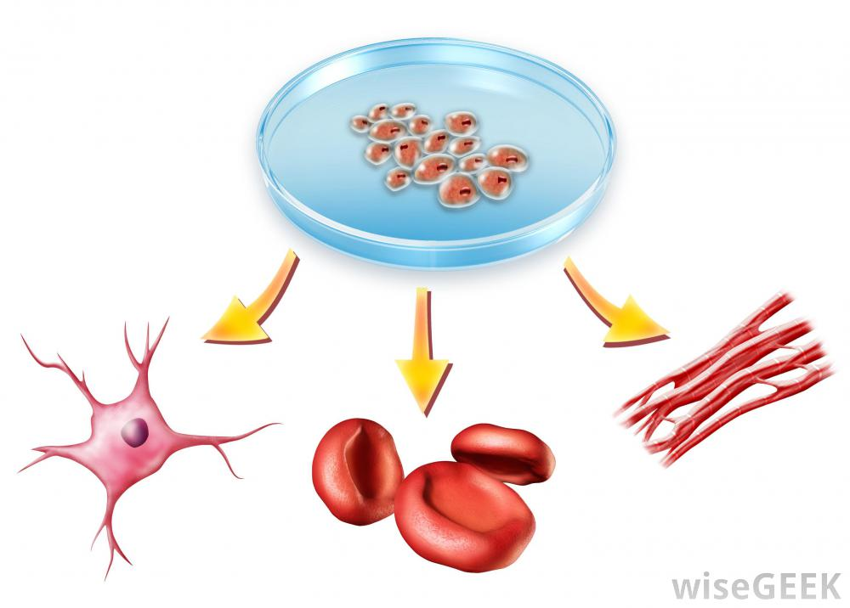
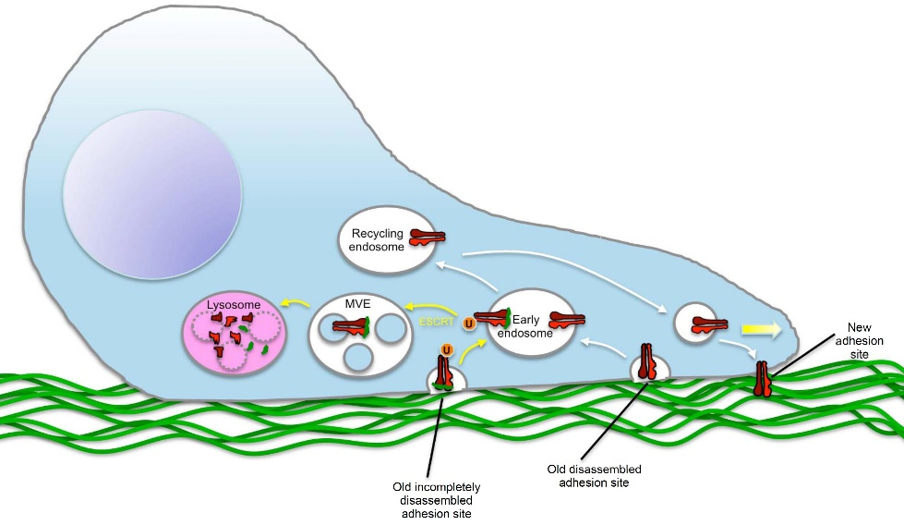
Where and how does FOXE1 function?
Cellular Component
Molecular Function
Biological Processes
Cell Migration
Cell Differentiation

Slide 7
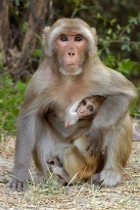
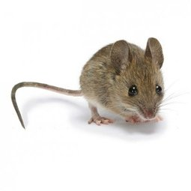
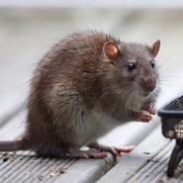
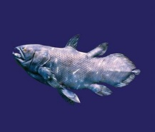
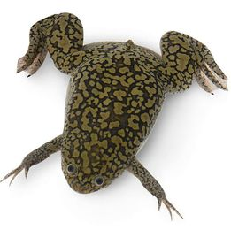
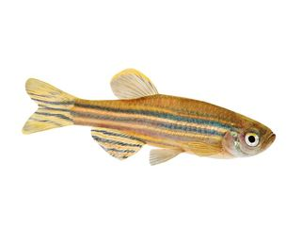
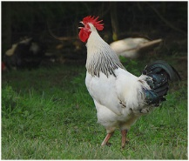
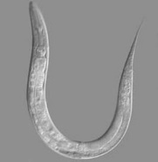
FOXE1 is highly conserved
% Identity
FH
373 aa
FH
372 aa
97%
FH
373 aa
91%
FH
371 aa
89%
FH
370 aa
88%
FH
349 aa
55%
FH
377 aa
49%
FH
354 aa
47%
FH
354 aa
40%
FH
323 aa
24%

Slide 8
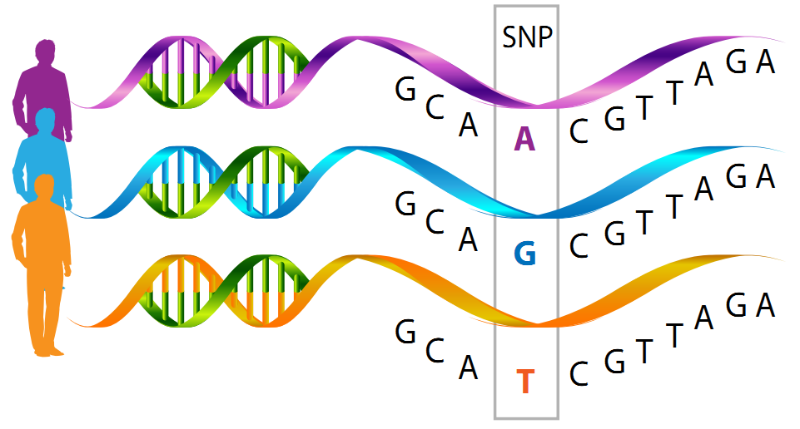
What is known about FOXE1?
Forkhead (FH) domain is responsible for sequence specific DNA binding
Mutations in the FH domain leads to congenital hypothyroidism
Mutations in the Low Complexity Region (LCR) results in NMTC and is associated with an increased WNT5A gene expression.
Specific Single nucleotide polymorphisms (SNP)are associated with specific subtypes of NMTC

Slide 9
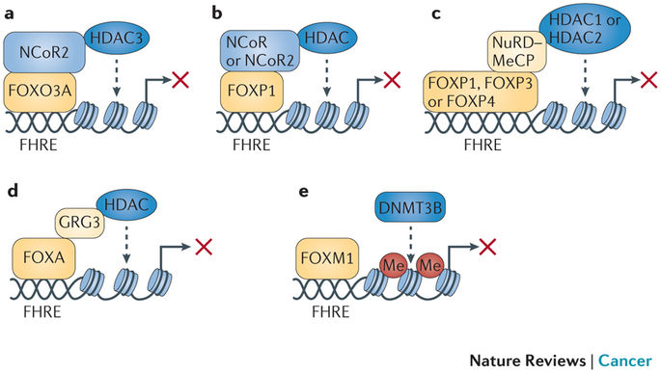
What is unknown about FOXE1?
Although protein-protein interaction networks indicate how FOXE1 may regulate gene transcription, there is little understanding regarding its mechanism

Slide 10
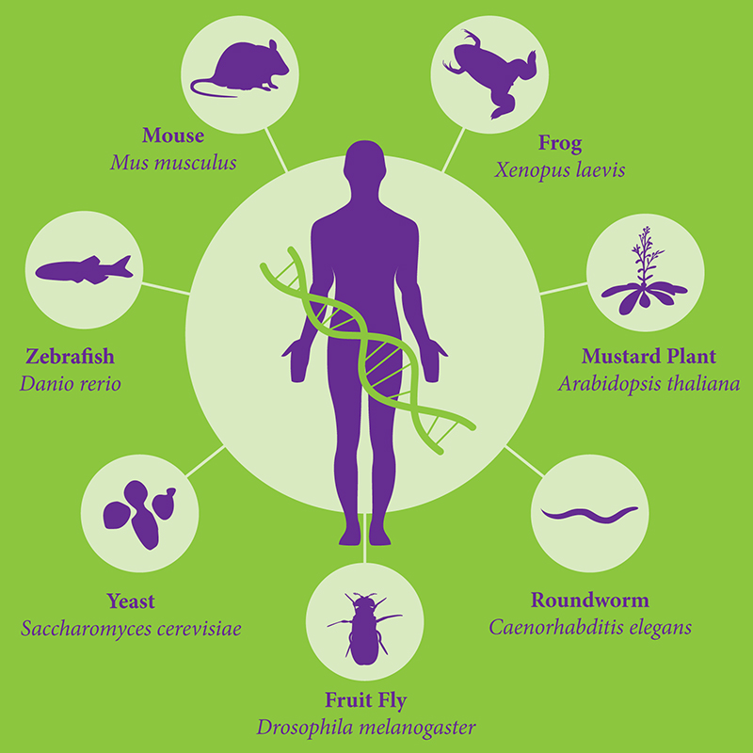
What model organisms should be utilized to study FOXE1?

Slide 11
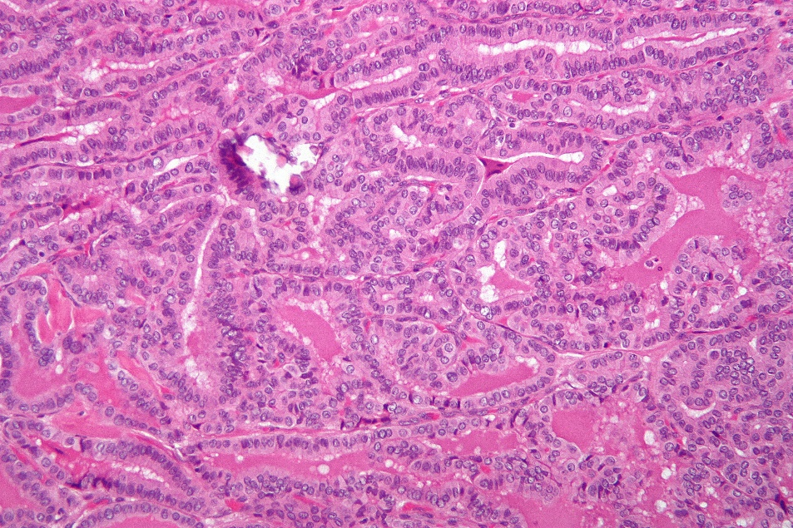
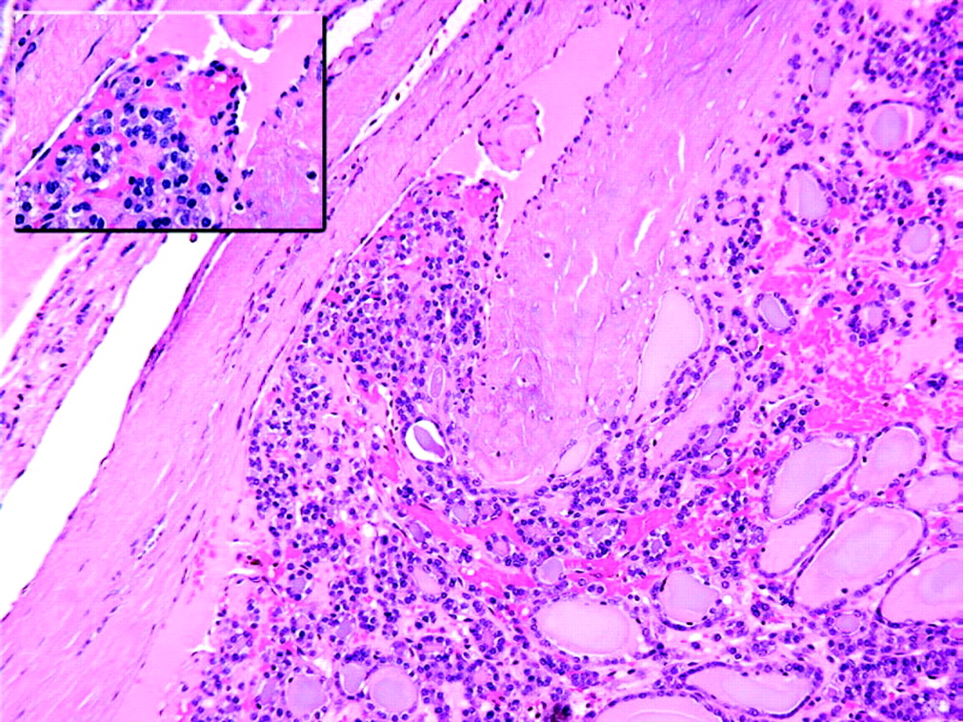
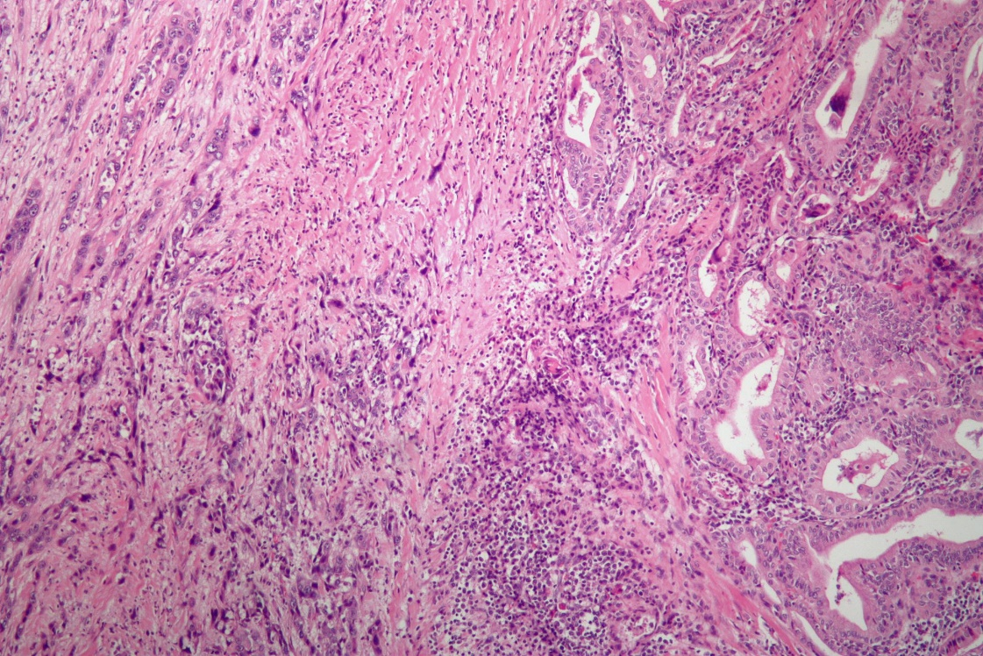
Why study mice for NMTC?
Papillary Thyroid Cancer
(PTC)
Follicular Thyroid Cancer
(FTC)
Anaplastic Thyroid Cancer
(ATC)
Psammoma bodies, well- formed fibrovascular cores, and ground glass appearance of nuclei observed
Capsular and vascular invasion observed
Poor cell differentiation observed
In both humans and mice, NMTC subtypes can be classified according to histopathological characteristics of the cell
(Microscopic Examination)

Slide 12
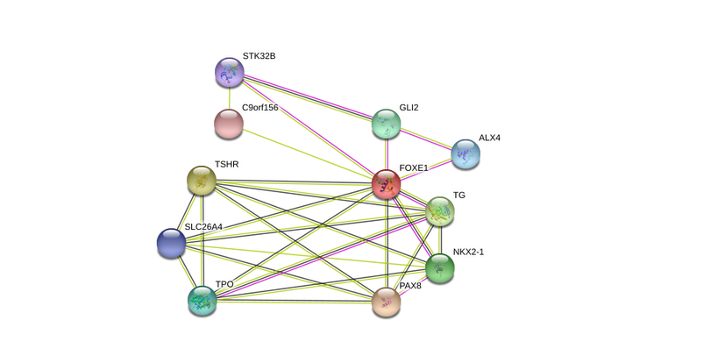
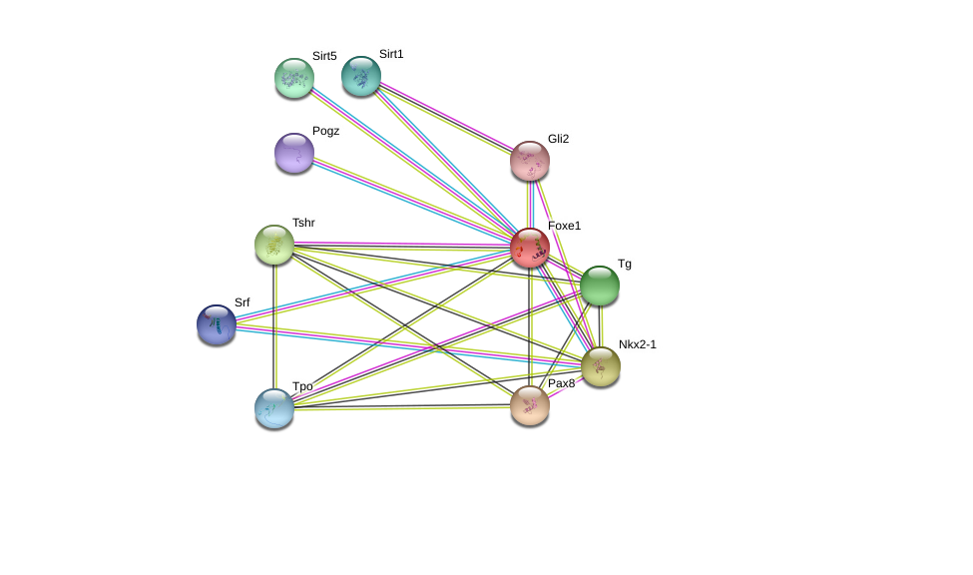
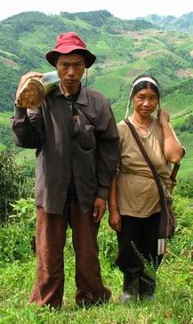
How do human and mouse FOXE1 interactions compare?
Embryonic organ morphogenesis,
Endocrine system development
Embryonic organ morphogenesis,
Endocrine system development
Thyroid gland development
Thyroid gland development

Slide 13
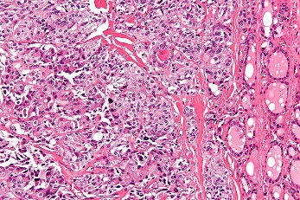
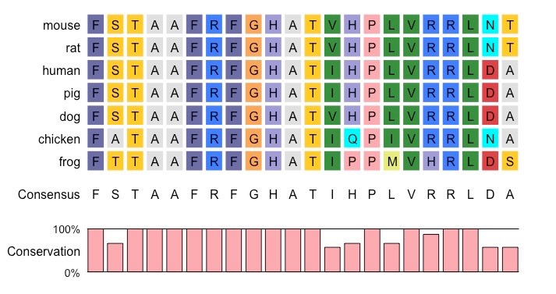
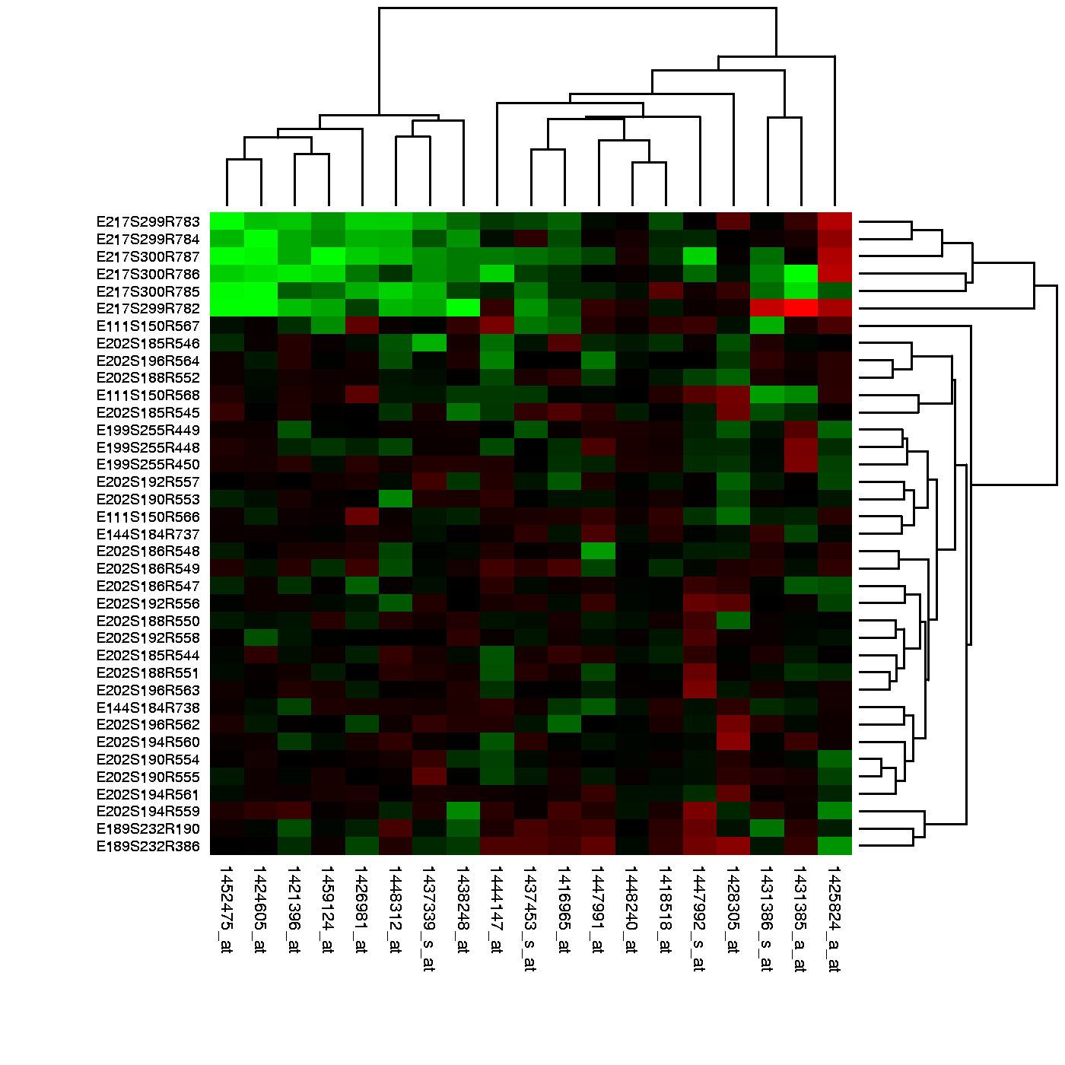
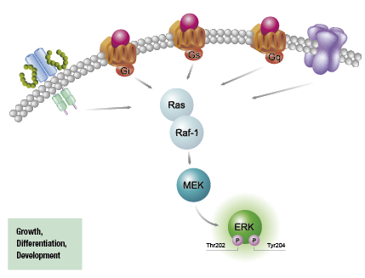
What is the primary goal?
Identify how FOXE1 is responsible for the uncontrolled growth of follicular cells within the thyroid gland
Aim 1
Aim 2
Aim 3
Identify conserved amino acid sequences that regulate cell growth/ proliferation
Identify genes involved in thyroid morphogenesis
Characterize phosphorylation patterns of NMTC

Slide 14
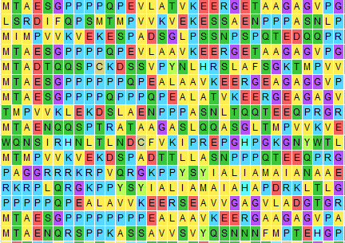
Aim 1: Identify conserved amino acids sequences that regulate cell growth/ proliferation
Ensembl
CRISPR-Cas9
Screen
MEGA

Slide 15
Aim 1: Identify conserved amino acids sequences that regulate cell growth/ proliferation
Ensembl
CRISPR-Cas9
Screen
MEGA
Induce NMTC subtype specific gene mutation using CRISPR
89%
94%

Slide 16
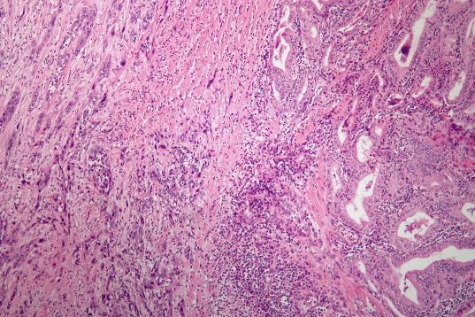
Aim 1: Identify conserved amino acids sequences that regulate cell growth/ proliferation
Ensembl
CRISPR-Cas9
MEGA
Screen
Hypothesis: Human NMTC subtype specific mutations will cause same NMTC subtypes in FOXE1 mutant mice

Slide 17
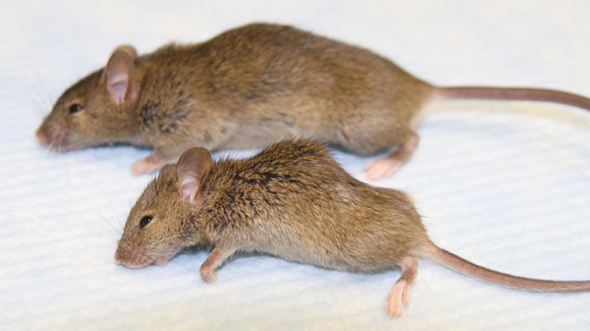
Aim 2: Identify genes involved in thyroid morphogenesis
Single-cell RNA-seq
GO
CRISPR & Screen
WT
Mutant

Slide 18
Aim 2: Identify genes involved in thyroid morphogenesis
Single-cell RNA-seq
GO
CRISPR & Screen

Slide 19
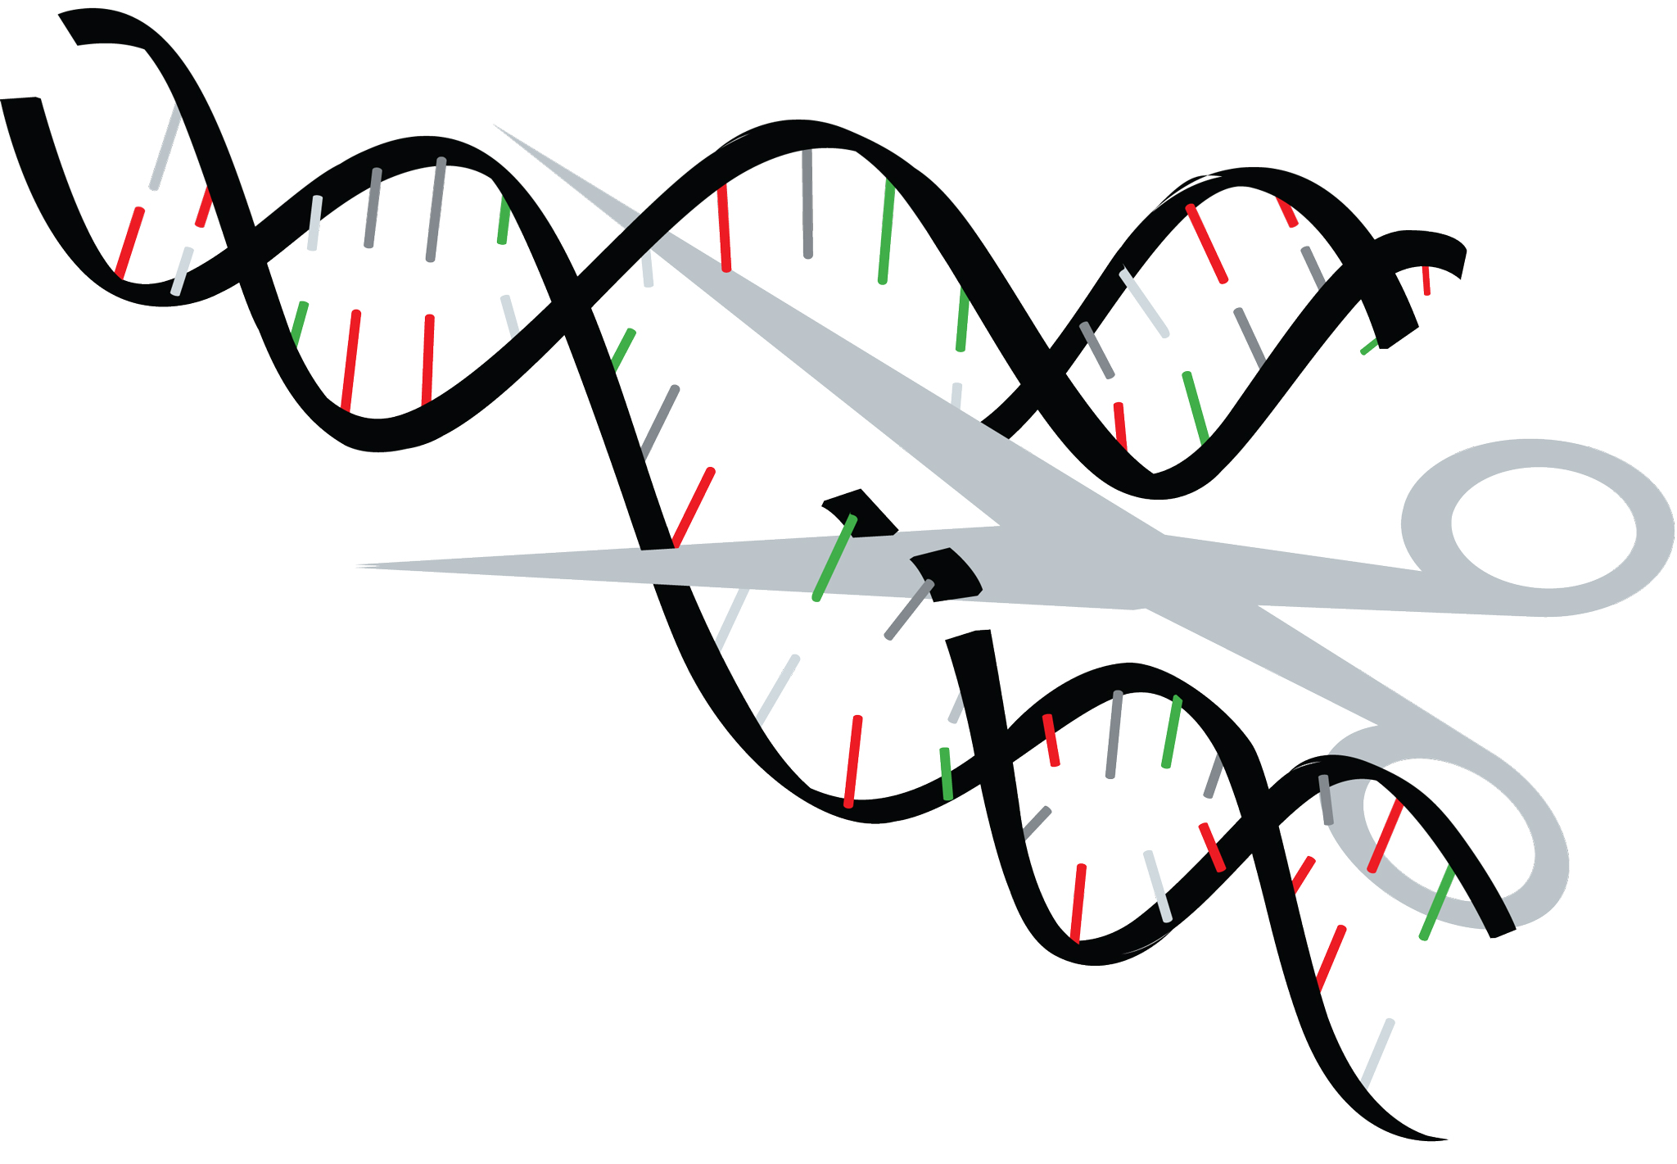
Aim 2: Identify genes involved in thyroid morphogenesis
Single-cell RNA-seq
GO
CRISPR & Screen
Hypothesis: Genes responsible for cellular growth regulation will be over or under expressed

Slide 20
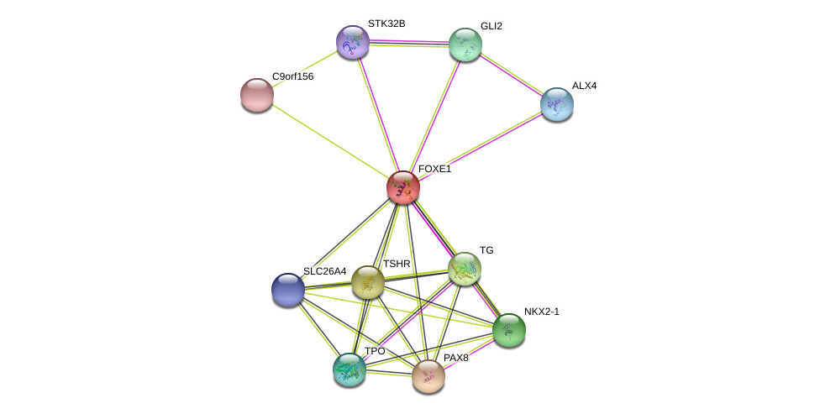
Aim 3: Characterize phosphorylation patterns of NMTC
Protein-protein Interactions
NETPHOS
Mass Spec.
Identify proteins that interact with FOXE1

Slide 21
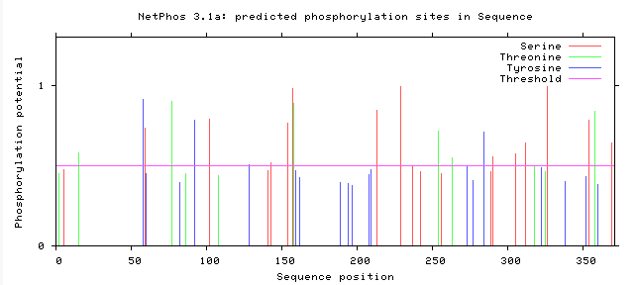
Aim 3: Characterize phosphorylation patterns of NMTC
Protein-protein interactions
NETPHOS
Mass Spec.
Identify putative phosphorylation sites for FOXE1 and FOXE1 interacting proteins

Slide 22
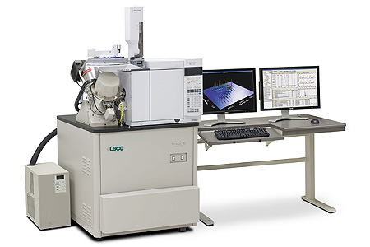
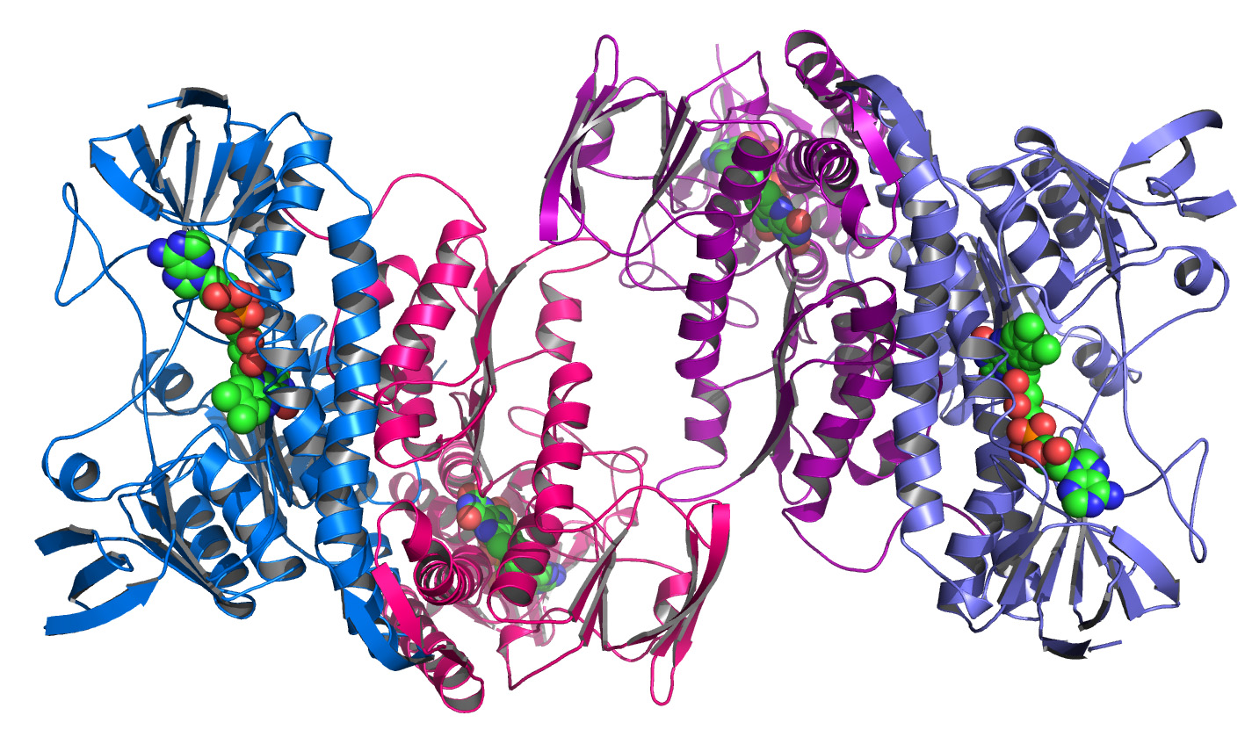
Aim 3: Characterize phosphorylation patterns of NMTC
Protein-protein interactions
NETPHOS
Mass Spec.
Hypothesis: FOXE1, as well as FOXE1 interacting proteins responsible for cell growth/ proliferation will be over-phosphorylated

Slide 23
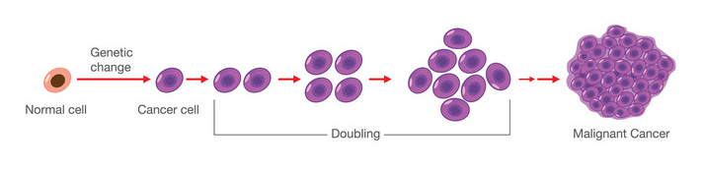
Future Directions
Identify regulatory roles and mechanisms of FOXE1 low complexity regions
X
Identify ways to stop NMTC progression

Slide 24
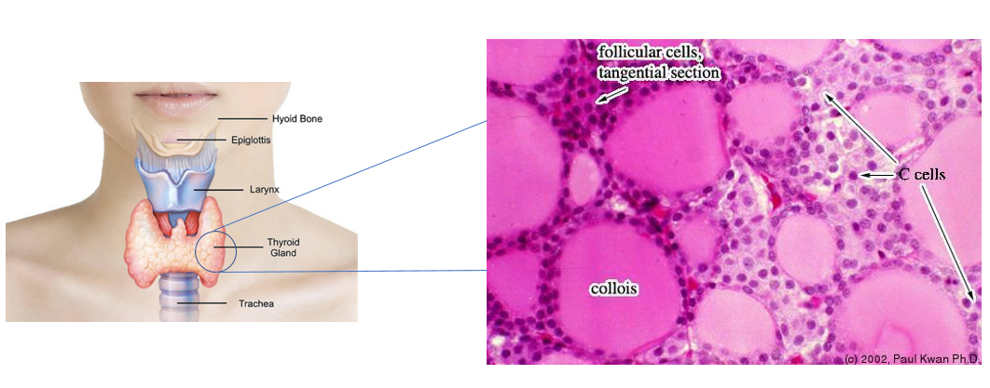
Conclusion
NMTC is the uncontrolled growth of thyroid follicular cells
Low complexity regions of FOXE1 are associated with NMTC
Understanding FOXE1’s mechanism of transcription regulation may help identify ways to stop NMTC progression
X

Slide 25
References
Kirschner L. S., Qamri Z., Kari S., Ashtekar A. (2015) “Mouse models of thyroid cancer: A 2015 update,” Molecular and Cellular Endocrinology, 421, 18-27.
http://ent.uci.edu/more-at-uc-irvine/conditions/images/thyroid-cancer.jpg
http://ocw.tufts.edu/data/4/221047/221077_xlarge.jpg
http://1.bp.blogspot.com/-vtC-abWusoI/UoWFIxsIdpI/AAAAAAAAChE/HskPRzy3jCc/s1600/thyroid.png
http://blog.dana-farber.org/insight/2017/09/thyroid-cancer-symptoms-signs/
http://slideplayer.com/slide/4830904/15/images/45/DNA+Transcription+RNA+Nucleus+Cytoplasm.jpg
https://www.ous-research.no/institute/images/news/2010/integrin-degradation.jpg
http://images.wisegeek.com/cell-differentiation-diagram.jpg
https://www.whatisdna.net/wp-content/uploads/2016/11/SNP.png
https://biology.uiowa.edu/sites/biology.uiowa.edu/files/model_organisms.jpg
https://www.cisbio.com/sites/default/files/htrf/products/kinase-pathway_phospho-ERK.png
https://www.scienceofmassage.com/wp-content/uploads/2017/05/DRJEFF1.png
https://en.wikipedia.org/wiki/Anaplastic_thyroid_cancer#/media/File:Anaplastic_thyroid_carcinoma_low_mag.jpg
http://www.wikidoc.org/images/0/0b/Medullary_thyroid_carcinoma_-_high_mag.jpg
http://www.ib.bioninja.com.au/_Media/multiple-alignment-2_med.jpeg
https://static1.squarespace.com/static/57a2155f579fb340501cef73/t/59c19a4049fc2beaafbd1fca/1505859473687/CRISPR%3ACas9.jpg
https://s3.amazonaws.com/go-public/image/go-logo.large.png
https://i.ytimg.com/vi/0h5jM7eN6j4/maxresdefault.jpg
https://seer.cancer.gov/statfacts/html/thyro.html
https://upload.wikimedia.org/wikipedia/commons/6/65/Papillary_thyroid_carcinoma_tall_cell_var_intermed_mag.jpg

Slide 26
References
21. http://www.drugline.org/img/term/transcription-factor-15233_0.jpg
22. http://dev.biologists.org/content/develop/143/24/4558/F1.large.jpg
23. https://media.nature.com/m685/nature-assets/nrc/journal/v13/n7/images/nrc3539-f4.jpg
24. https://www.researchgate.net/profile/Ken_Yamashita3/publication/266625227/figure/fig1/AS:203126704480260@1425440588553/Upper-wild-type-mouse-lower-Klotho-mutant-mouse-The-Klotho-mouse-is-smaller-in-size.png
25. http://www.haematologica.org/content/haematol/96/3/408/F3.large.jpg
26. http://discovermagazine.com/~/media/Images/Issues/2014/JanFeb/snip-DNA.jpg
27. http://www.consulente-energia.com/iz113.jpg
28. http://www.tuscany-diet.net/wp-content/uploads/2015/04/protein-structure.jpg
29. http://jcp.bmj.com/content/jclinpath/60/3/244/F2.large.jpg
30. https://www.utmb.edu/otoref/Grnds/Thyroid-CA-021204/Thyroid-CA-021204-slides.pdf

