Slide 1
FOXE1 and Non Medullary Thyroid Cancer (NMTC)

Slide 2
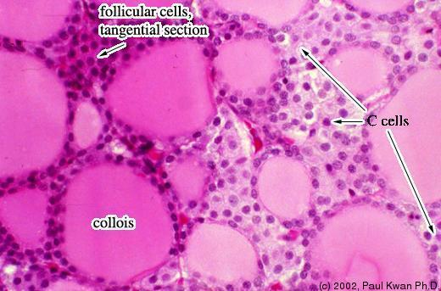
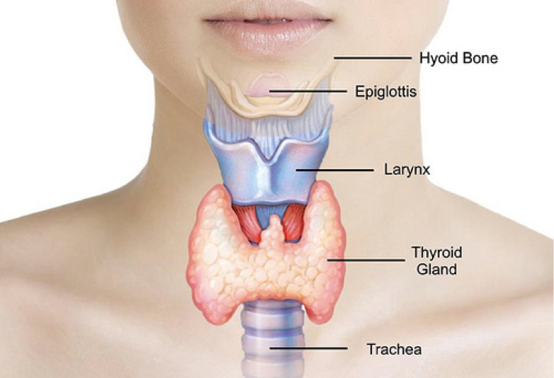
What is Non Medullary Thyroid Cancer?
Abnormal growth of thyroid follicular cells

Slide 3
What are the symptoms of NMTC?

Slide 4
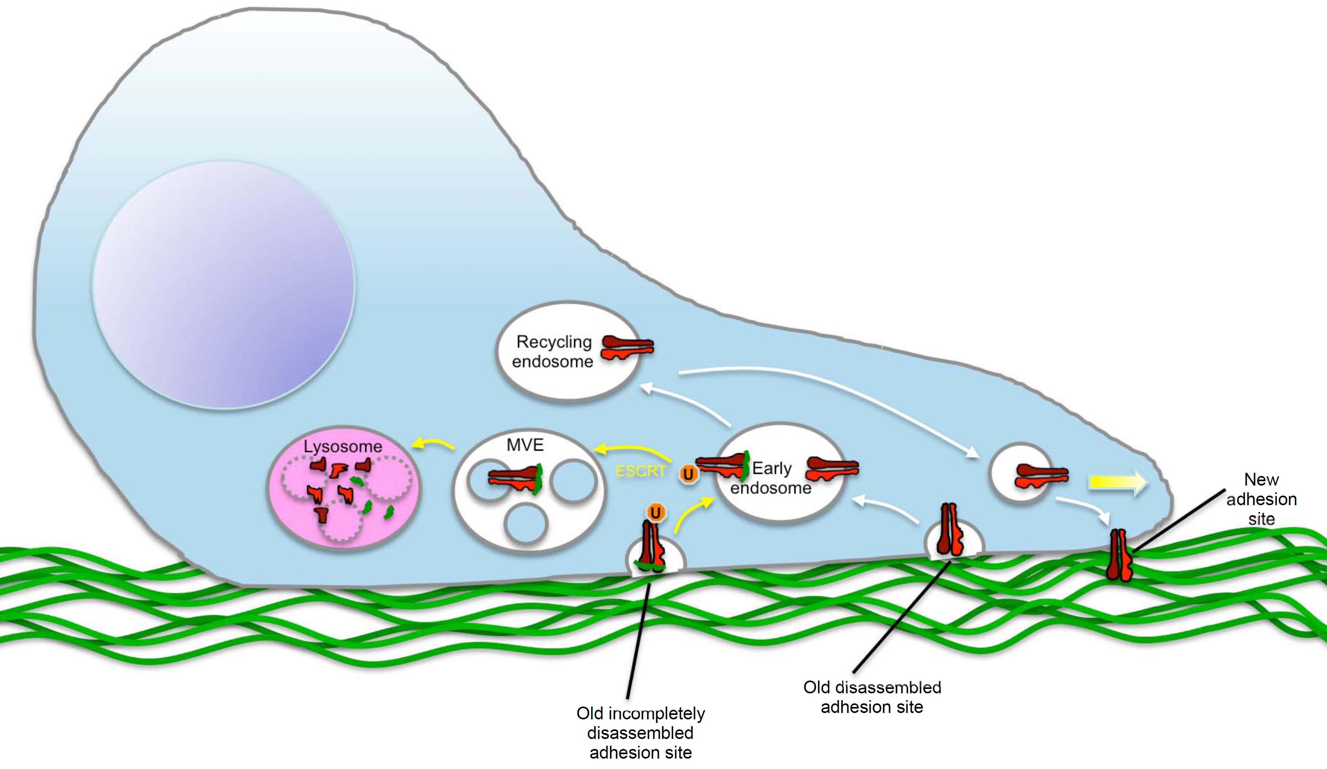
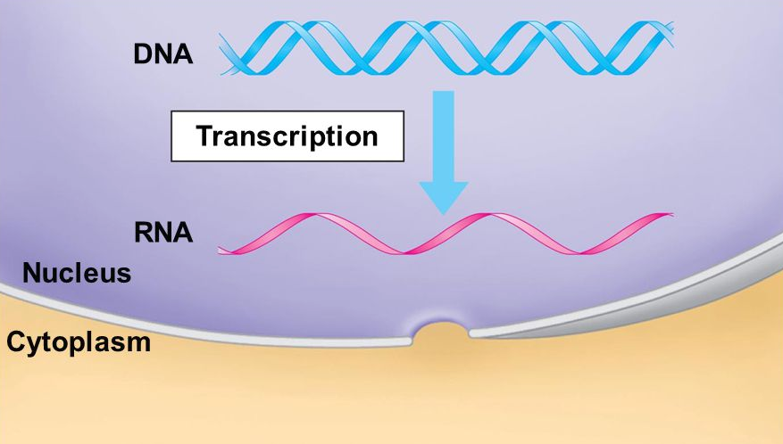
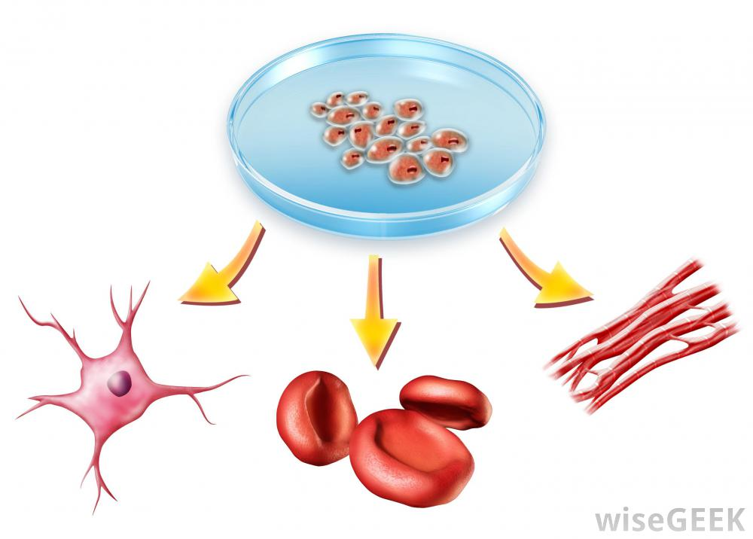
Where and how does FOXE1 function?
Cell Migration
Cell Differentiation

Slide 5
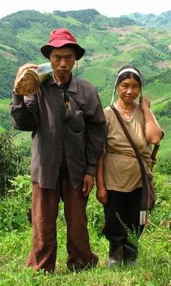
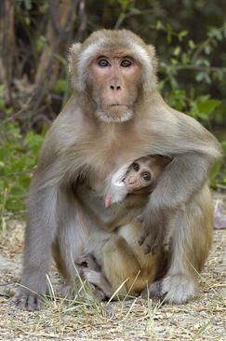
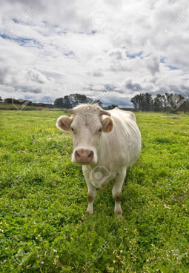
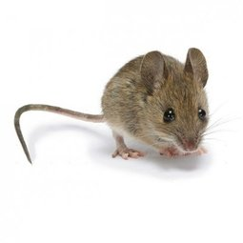
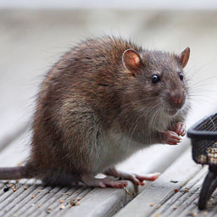
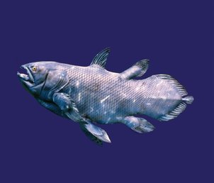
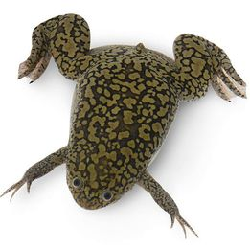
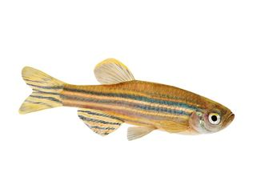
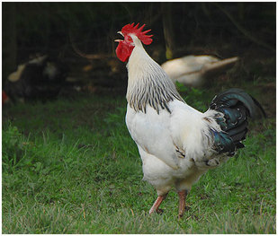
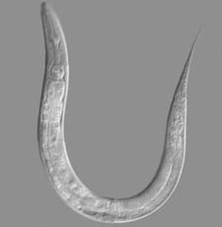
Is FOXE1 conserved across species?
FH
373 aa
FH
372 aa
97%
FH
373 aa
91%
FH
371 aa
89%
FH
370 aa
88%
FH
349 aa
55%
FH
377 aa
49%
FH
354 aa
47%
FH
354 aa
40%
323 aa
24%
FH

Slide 6
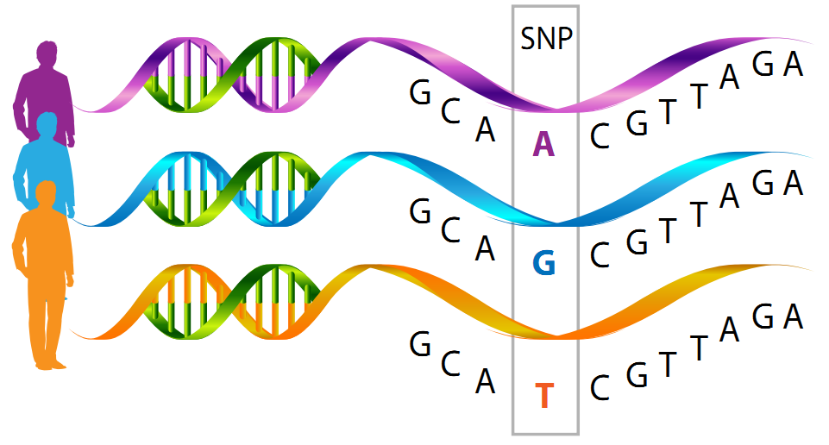
How does FOXE1 mutations cause NMTC?
?
Specific Single nucleotide polymorphisms (SNP)are associated with specific subtypes of NMTC

Slide 7
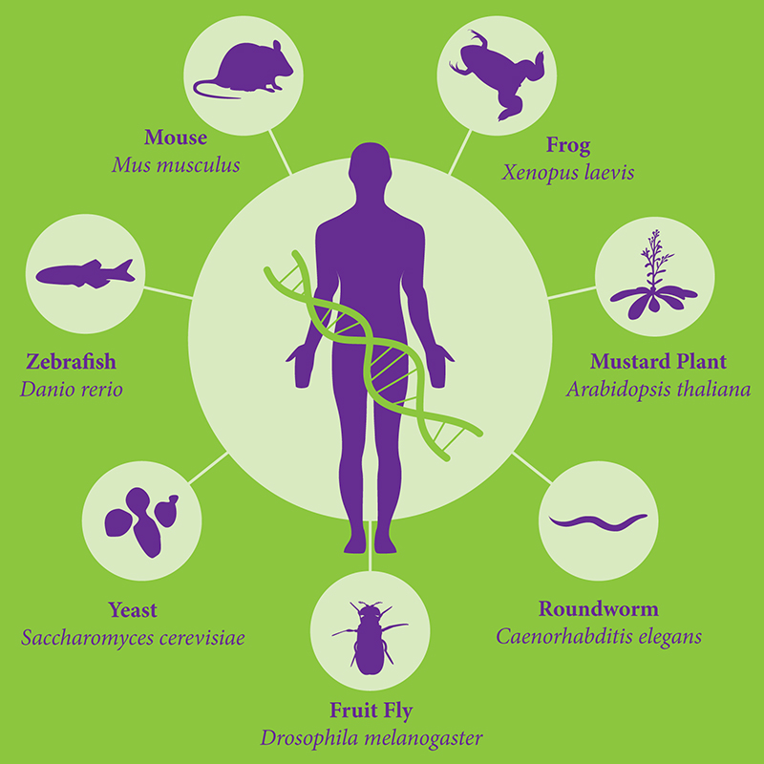
What model organism should be used to study the role of FOXE1 in NMTC?

Slide 8
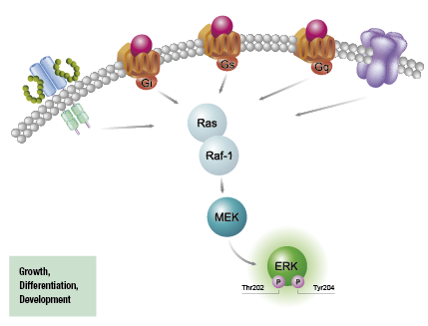
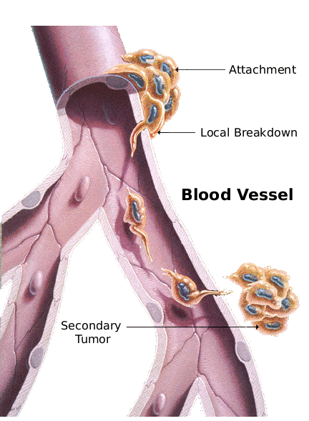
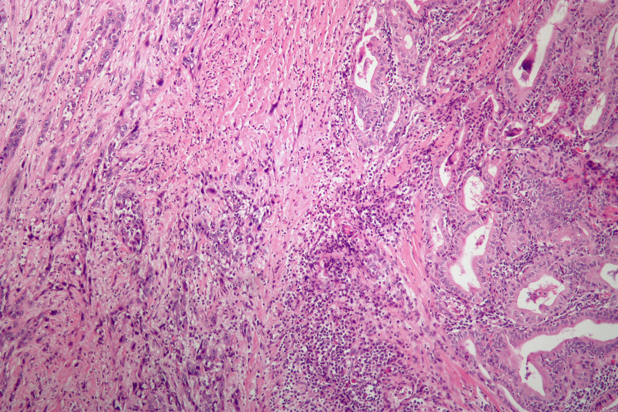
Why study mice for NMTC?
Papillary Thyroid Cancer
(PTC)
Follicular Thyroid Cancer
(FTC)
Anaplastic Thyroid Cancer
(ATC)
FTC exhibits an identifiable hematogenous spread pattern in mice and humans
ATC is identifiable by its poor cell differentiation in both humans and mice
Activation of ERK signaling pathway observed in both humans and mice

Slide 9
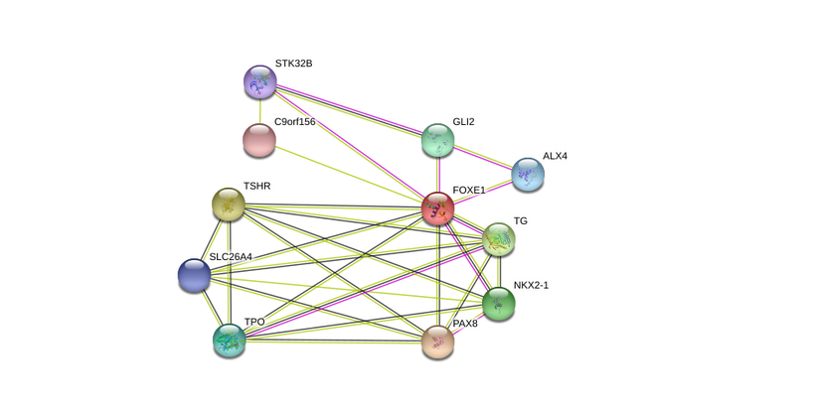
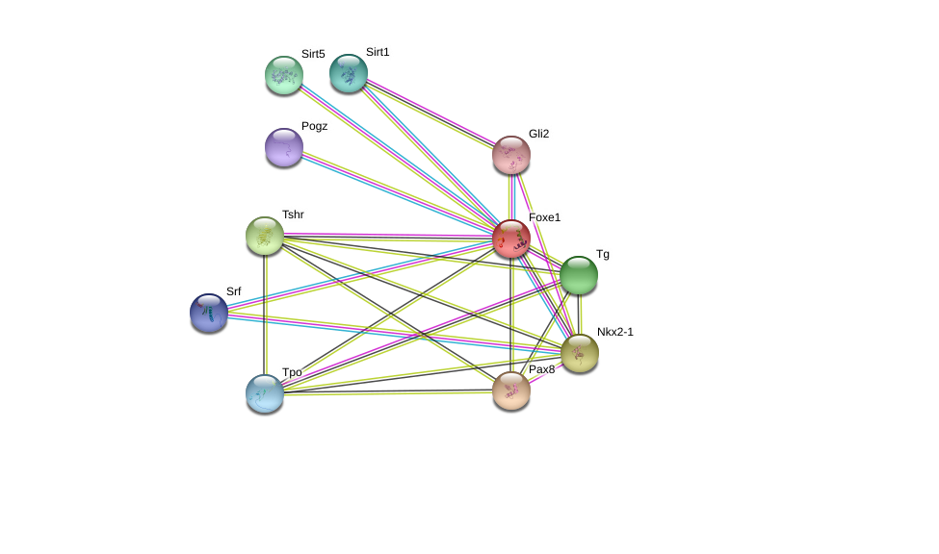
How do human and mouse FOXE1 interactions compare?
Embryonic organ morphogenesis,
Endocrine system development
Embryonic organ morphogenesis,
Endocrine system development
Thyroid gland development
Thyroid gland development

Slide 10
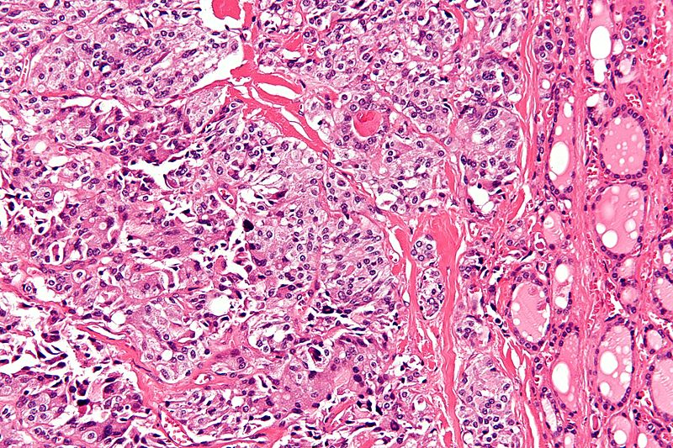
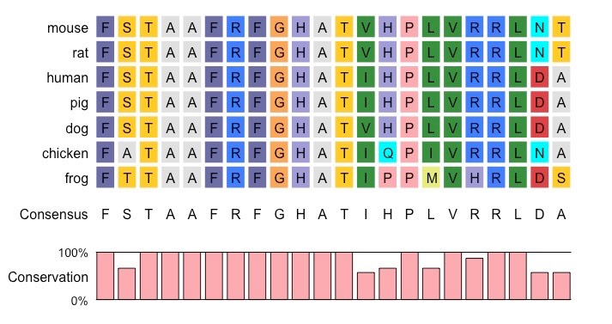
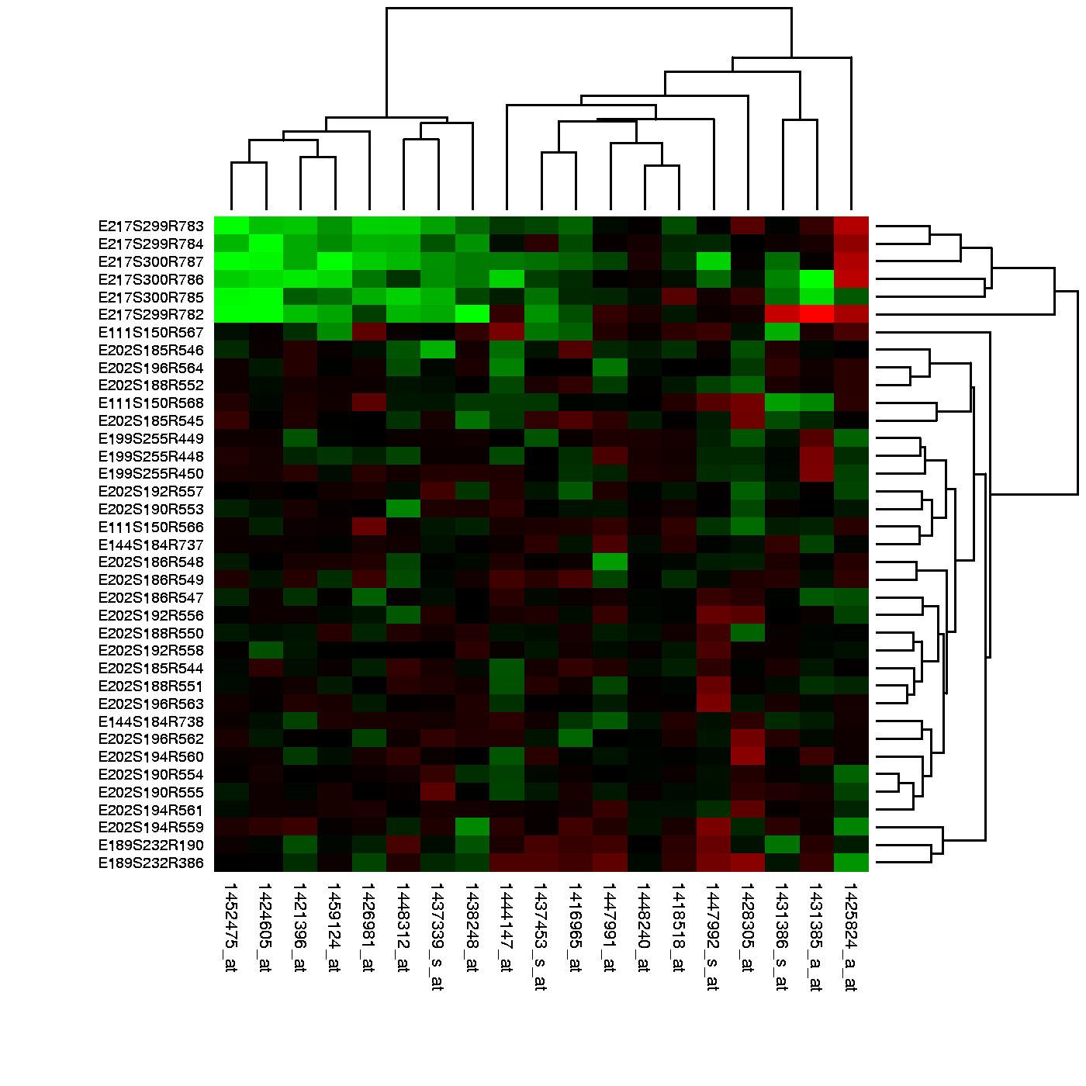
What is the primary goal?
Identify how FOXE1 is responsible for the uncontrolled growth of follicular cells within the thyroid gland
Aim 1
Aim 2
Aim 3
Identify conserved amino acid sequences that regulate cell growth/ proliferation
Identify genes involved in thyroid morphogenesis
Characterize phosphorylation patterns of NMTC

Slide 11
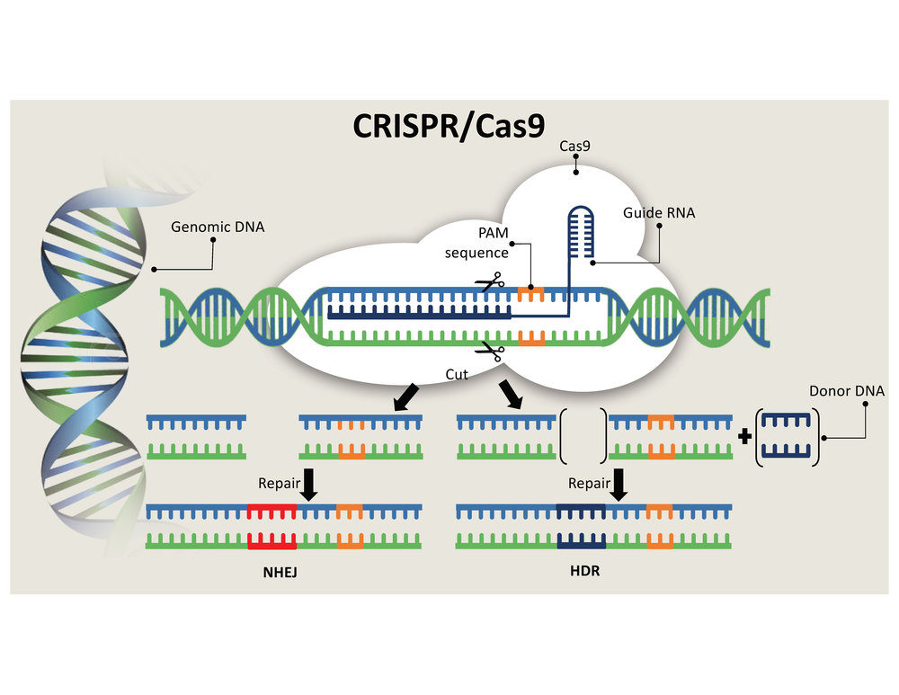
Aim 1: Identify conserved amino acids sequences that regulate cell growth/ proliferation
Ensembl
CRISPR-Cas9
Screen

Slide 12
Aim 2: Identify genes involved in thyroid morphogenesis
Single-cell RNA-seq
GO
Mutate & Screen

Slide 13
References
Kirschner L. S., Qamri Z., Kari S., Ashtekar A. (2015) “Mouse models of thyroid cancer: A 2015 update,” Molecular and Cellular Endocrinology, 421, 18-27.
http://ent.uci.edu/more-at-uc-irvine/conditions/images/thyroid-cancer.jpg
http://ocw.tufts.edu/data/4/221047/221077_xlarge.jpg
http://1.bp.blogspot.com/-vtC-abWusoI/UoWFIxsIdpI/AAAAAAAAChE/HskPRzy3jCc/s1600/thyroid.png
http://blog.dana-farber.org/insight/2017/09/thyroid-cancer-symptoms-signs/
http://slideplayer.com/slide/4830904/15/images/45/DNA+Transcription+RNA+Nucleus+Cytoplasm.jpg
https://www.ous-research.no/institute/images/news/2010/integrin-degradation.jpg
http://images.wisegeek.com/cell-differentiation-diagram.jpg
https://www.whatisdna.net/wp-content/uploads/2016/11/SNP.png
https://biology.uiowa.edu/sites/biology.uiowa.edu/files/model_organisms.jpg
https://www.cisbio.com/sites/default/files/htrf/products/kinase-pathway_phospho-ERK.png
https://www.scienceofmassage.com/wp-content/uploads/2017/05/DRJEFF1.png
https://en.wikipedia.org/wiki/Anaplastic_thyroid_cancer#/media/File:Anaplastic_thyroid_carcinoma_low_mag.jpg
http://www.wikidoc.org/images/0/0b/Medullary_thyroid_carcinoma_-_high_mag.jpg
http://www.ib.bioninja.com.au/_Media/multiple-alignment-2_med.jpeg
https://static1.squarespace.com/static/57a2155f579fb340501cef73/t/59c19a4049fc2beaafbd1fca/1505859473687/CRISPR%3ACas9.jpg
https://s3.amazonaws.com/go-public/image/go-logo.large.png

